Slide 1
900 MHz - aligning with the rest of the world
Presentation for RS2017
David Donachie
18 May 2017

Slide 2
900 MHz – aligning with the rest of the world
Spectrum harmonisation is essential for the economies of scale
Reduces costs
Improves efficiency
Makes life easier

Slide 3
900 MHz – aligning with the rest of the world
Europe has 868 MHz
Provides similar opportunities but limited bandwidth
Many restrictions e.g. Duty Cycles, LBT, AFA, etc.
Won’t meet rapid growth in demand for applications such as RFID and M2M
Industry pressure now to find additional sub GHz spectrum to support future growth

Slide 4
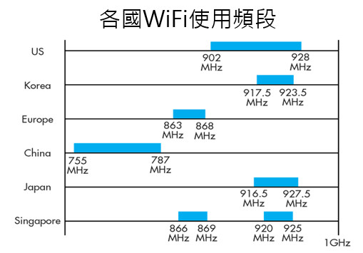
900 MHz – aligning with the rest of the world
902 - 928 MHz increasingly used in North America and elsewhere

Slide 5
900 MHz – aligning with the rest of the world
902 - 928 MHz
High power
Long range
small antenna size
Good obstacle / building penetration
Suited to lower bit rate applications (high data rate applications moving higher GHz)

Slide 6
900 MHz – aligning with the rest of the world
A big prize…however!
Licensed public cellular below 915 MHz and above 925 MHz
Some spectrum reserved for possible future national railway systems
Some existing military use
Some other uses, e.g. meteorological

Slide 7
900 MHz – aligning with the rest of the world
The UK work
Opened 870-876 and 915 – 921 MHz in 2014
UK Ministry of Defence handed spectrum back - military users cleared
Option for possible additional railway spectrum based on technical need
10 other countries also opened these bands
Now need the rest of Europe to align too to get full benefits

Slide 8
900 MHz – aligning with the rest of the world
ETSI and CEPT work on 870-876 / 915-921 MHz
ETSI - Industry Request - System Reference Documents
CEPT - Spectrum sharing and compatibility studies – CEPT and ECC Reports
CEPT - recently presented possible harmonisation measures for these bands in the “Addendum to CEPT Report 59” sent to EC

Slide 9
900 MHz – aligning with the rest of the world
Way forward
EC currently trying to find a way forward after CEPT work
EC workshop on 19 June in Brussels
Industry needs to highlight the economic and societal benefits of SRD global harmonisation to their respective national administrations
The competing national spectrum needs cost v benefits should be evaluated
Too big an opportunity to miss!

Slide 10
900 MHz – aligning with the rest of the world
Thank you!
Q&A
David.Donachie@Ofcom.org.uk

